Slide 1
YOLO Object detection

Slide 2
Sliding window
Regions were selected corresponding to the predefined bounding boxes.
The chosen bounding boxes may or may not match perfectly with the position of our object.

Slide 3
You Only Look Once (YOLO)
In YOLO algorithm, we make use of grids on our images. The grid size depends on the training process.
The basic idea is to take the image classification and localization algorithm we saw and apply that to each of the grid cells.
This tells us that if there is any object present in any of the grid cells.

Slide 4
If a object is present in any of the grid cells, the algorithm takes the mid-point of the object and assigns the object to that grid cell that contains the mid-point.
Assumption - The mid-point will always be in a single grid cell.
Training - We’ll not be running each of the grid cells seperately through the network. Similar to the convolutional implementation of sliding window algorithm, we run the entire image and output a volume.

Slide 5
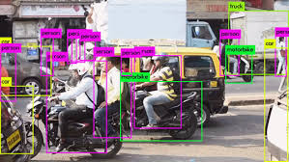
The true labels and the output volume are used to perform back-propagation to train the network.

Slide 6
As long as we don’t have more than one object (mid-point) in a single grid cell, this algorithm works well.
Using a finer grid size (25*25), gives more accuracy and avoids the chance that multiple objects being assigned to the same grid cell.
YOLO algorithm allows the network to output bounding boxes of any aspect ratio that are very precise.

Slide 7
How the bounding box values are represented?
The convention used is that each grid cell’s upper left is taken as (0,0) and bottom right is taken as (1,1).
The mid-points will always be between (0,1). The height and width of the object may be larger and may occupy multiple grid cells.

Slide 8
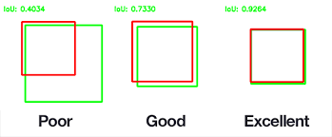
Intersection Over Union (IOU)

Slide 9
Problems
The same object may be detected multiple times by different grid cells. Non-max suppression is a method to ensure that each object is detected only once.

Slide 10
